Slide 1



MESS MONITORING
RGUKT-SRIKAKULAM
S200415--S.SAI SANTHOSH

Slide 2

PROBLEM STATEMENT
Our university mess caters to over 2000 students daily, creating a high volume of potential complaints.
The current system lacks proper mechanisms for tracking and resolving issues efficiently.
There are no effective communication channels between students and mess authorities.
These gaps lead to delayed responses, unresolved grievances, and dissatisfaction among students.

Slide 3


STUDENTS CONCERN AND GRIEVANCES
01
Hygiene Issue
05
Delay in Service
02
Quality Issue
06
Rude Behaviour
03
Quantity Issue
07
Cleanliness of Dining area
04
Taste Issue
08
Insufficient Seating

Slide 4


Proposed Solution:
Streamlining Mess Complaint Management
We propose a dedicated mobile application for mess complaint management. The app allows students to:
Raise Complaints: Select specific issues, upload proofs (e.g., images), and submit complaints easily.
Real-Time Updates: Notifications keep students informed about complaint status and resolutions.
Community Support: Students can like genuine complaints to highlight critical issues.
Continuous Reporting: Students can re-raise complaints if the problem persists.
Efficient Tracking: Authorities can track and address complaints systematically, ensuring accountability and timely resolution.

Slide 5

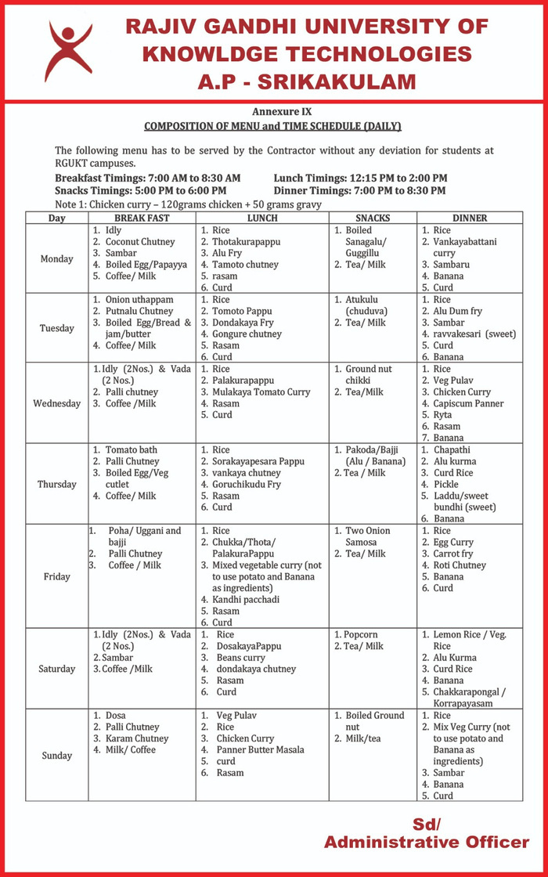
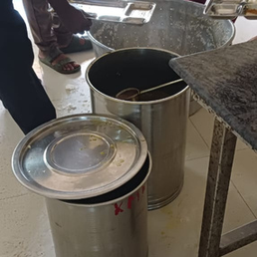
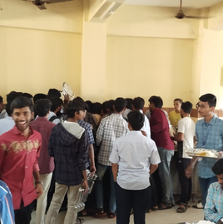
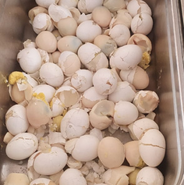

PROOFS:
LACK OF HYGIENE
THE HUNGER HORDE
UNCOOKED EGGS

Slide 6










SYSTEM WORK FLOW
Complain submission
Review and Resolve
Students select a specific category of issue and attach proof
Authorities review the complaint &w work towards resolving it
Notify students
Notify Resolution
All students receive notifications about the complaint and can support by liking
Once resolved,students are notified about the solution
Re-raise complaint
Generate tracking id
Each complaint is assigned a unique tracking id for monitoring
If unresolved,students can re-raise the complaint for further action

Slide 7
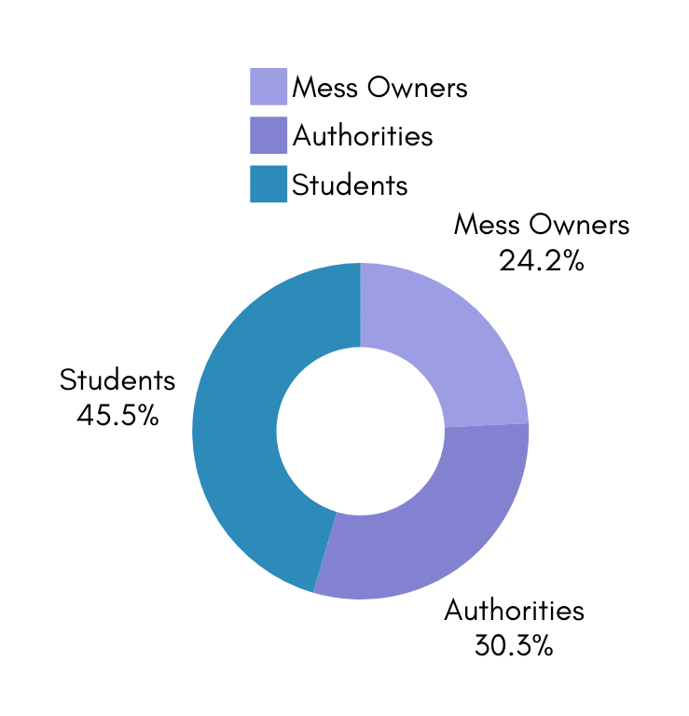


BENEFITS
Authorities: Achieve efficient tracking and resolution of complaints, improve accountability, and ensure faster intervention through easy escalation for serious issues.
Students: Achieve better communication, transparency, active participation in the complaint process, and timely updates on resolutions.
Mess Owners:Timely resolution of complaints leads to improved student satisfaction and better mess reputation.

Slide 8








IMPACTS OF THE MESS MONITORING
Improved Student Health and Safety
Better Quality Control
Continuous monitoring ensures food quality and hygiene standards are consistently met.
Regular checks help prevent foodborne illnesses and maintain a safe eating environment.
Efficient Resource Management
Proactive Issue Resolution
Monitoring helps optimize food supply, reducing waste and managing costs effectively.
Early detection of issues enables quicker fixes, preventing larger problems from arising.

Slide 9
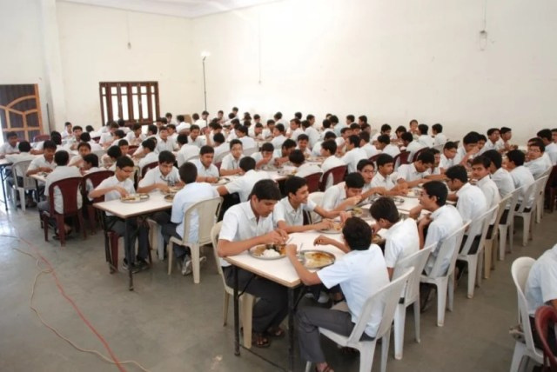

CONCLUSION
In conclusion, our Mess Monitoring System offers a comprehensive solution for streamlining operations in mess facilities. By leveraging technology, the system enhances efficiency, minimizes wastage, and ensures transparency in managing meals and resources. The project not only optimizes daily operations but also provides actionable insights for future improvements. This initiative demonstrates the potential of technology in transforming traditional management processes into smart, scalable systems.

Slide 10

Thank You

